Slide 1
Team Name: Omni
Phase: Two
Team Members:
Erick Omondi – Test Manager
Henok Girma – Risk Analyst
Lydia Awuor – Test Executor

Slide 2
Test Cases
During the testing of the CleanCity Waste Scheduler web application, we designed and executed 44 test cases to assess the system’s functionality, usability, and reliability. Our focus was to ensure that all core features worked as expected and that user interactions produced accurate and consistent results across all modules.

Slide 3
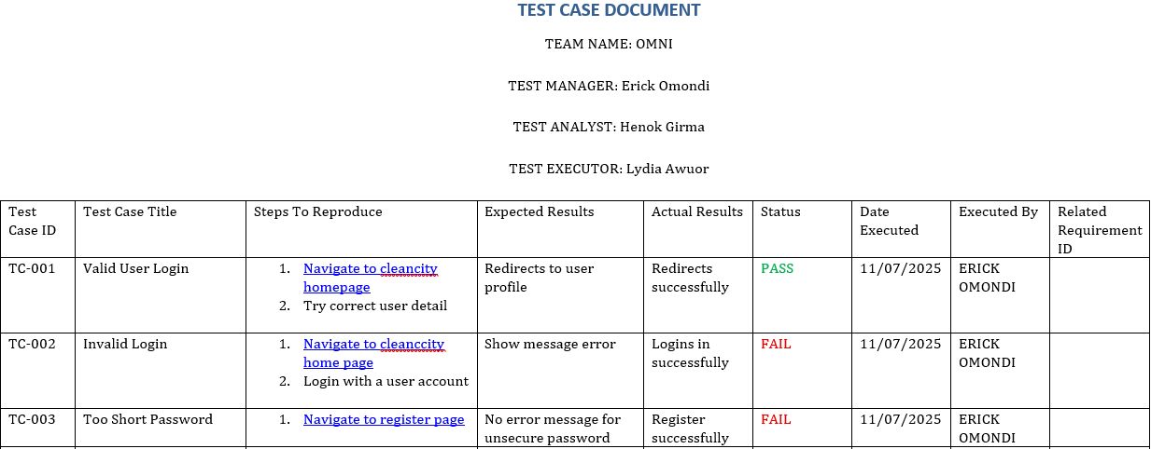
Attachment of Test Cases

Slide 4
Automated Test
We created a Selenium automation script that opened the CleanCity web app, entered login details, and successfully logged in showing how automation can quickly and accurately verify the login process.

Slide 5
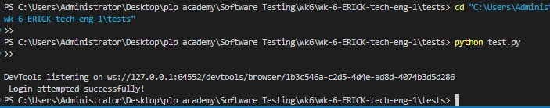
Automation Attachment

Slide 6
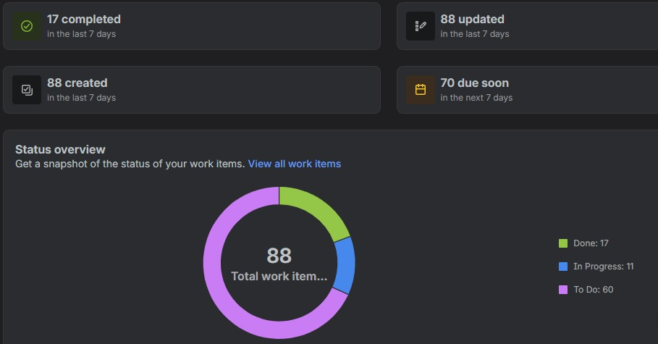
Jira Summary Report

